Slide 1



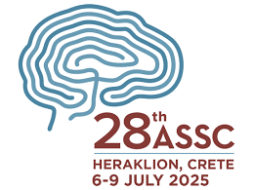


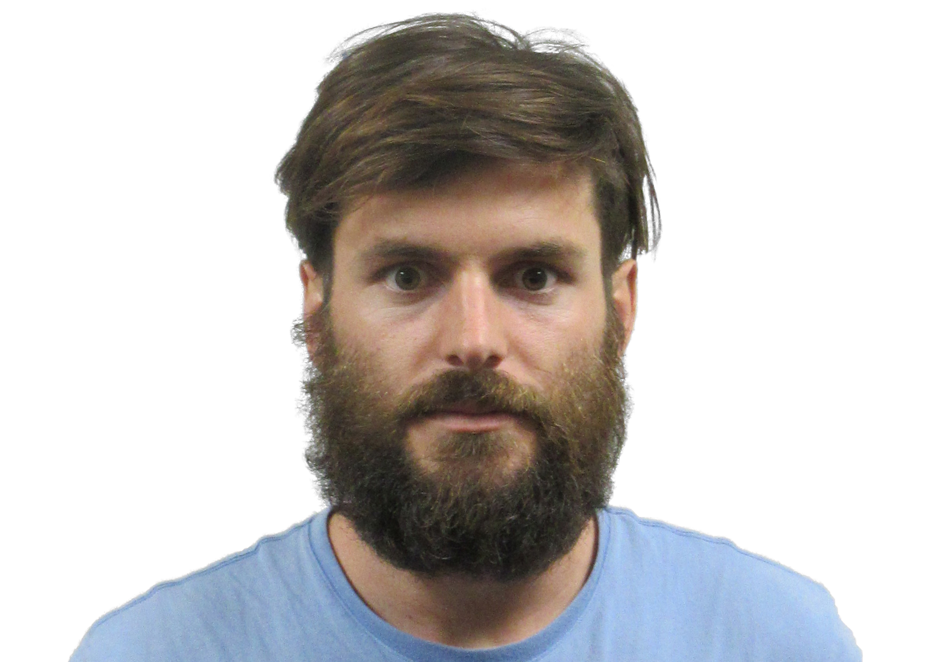

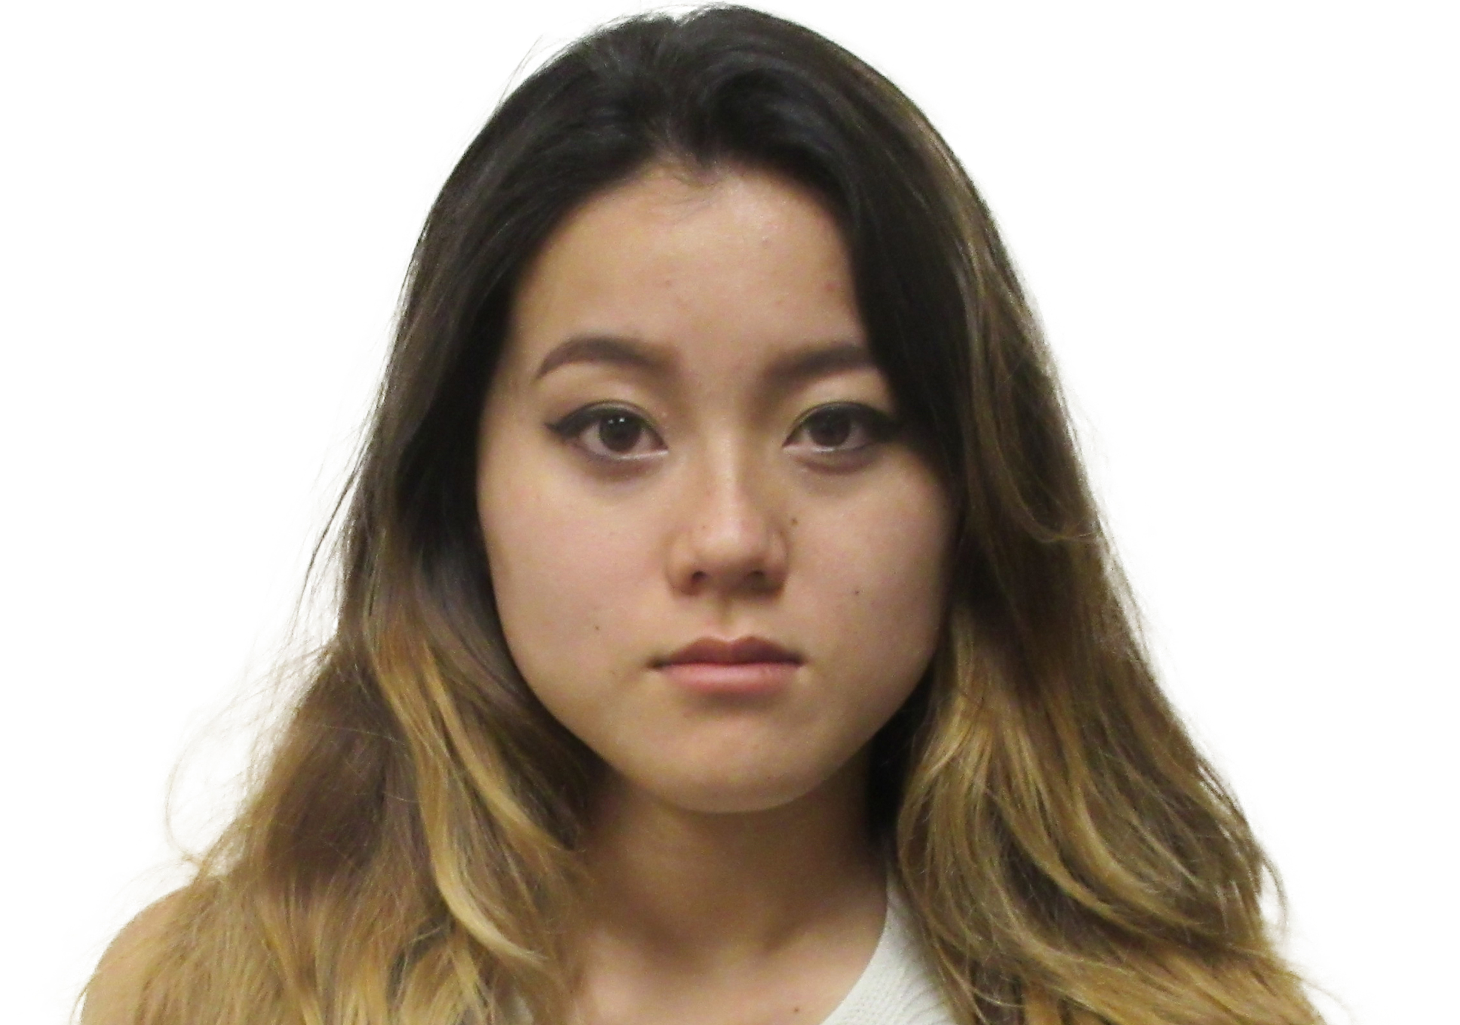
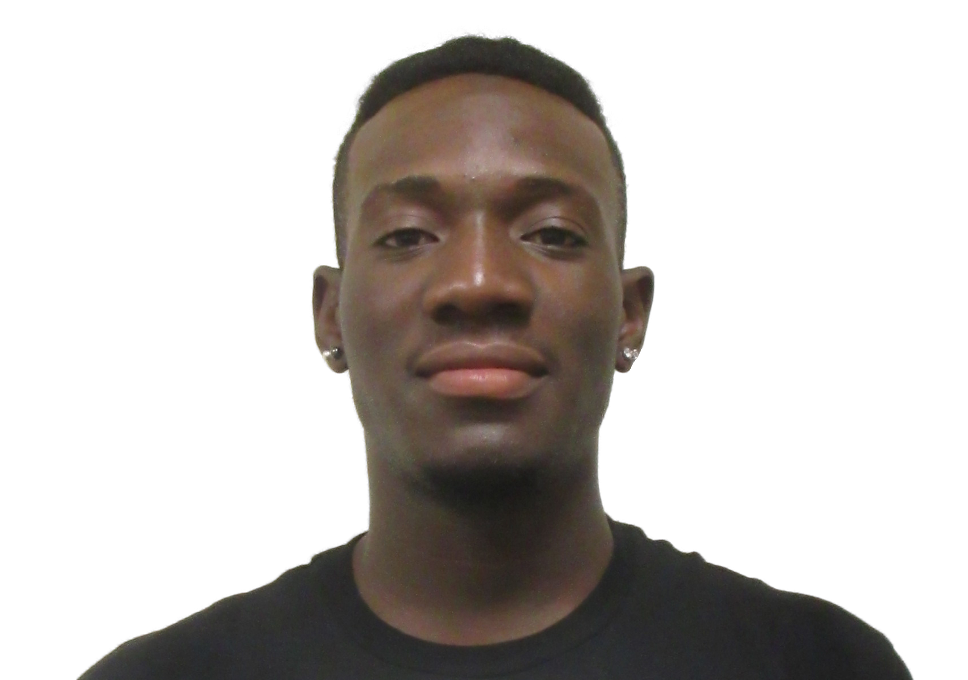
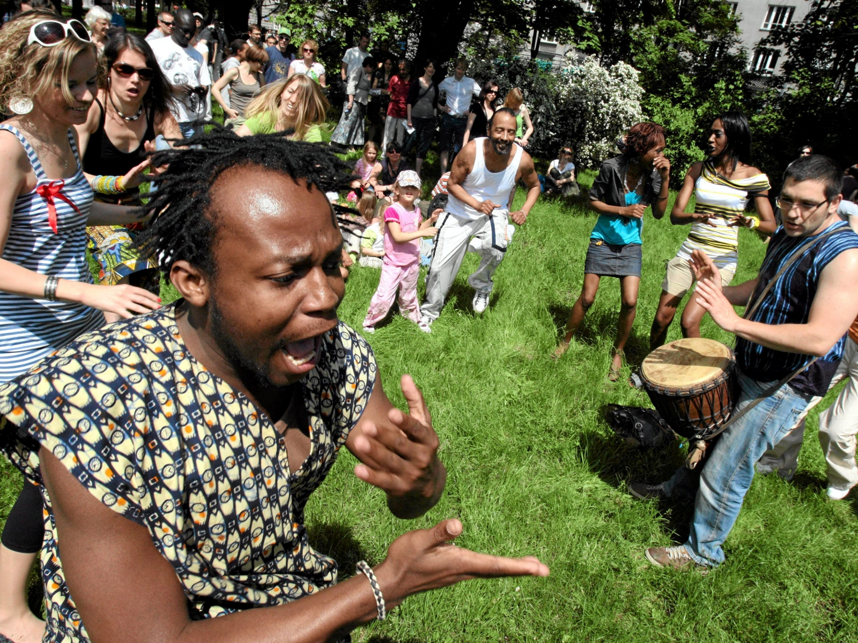
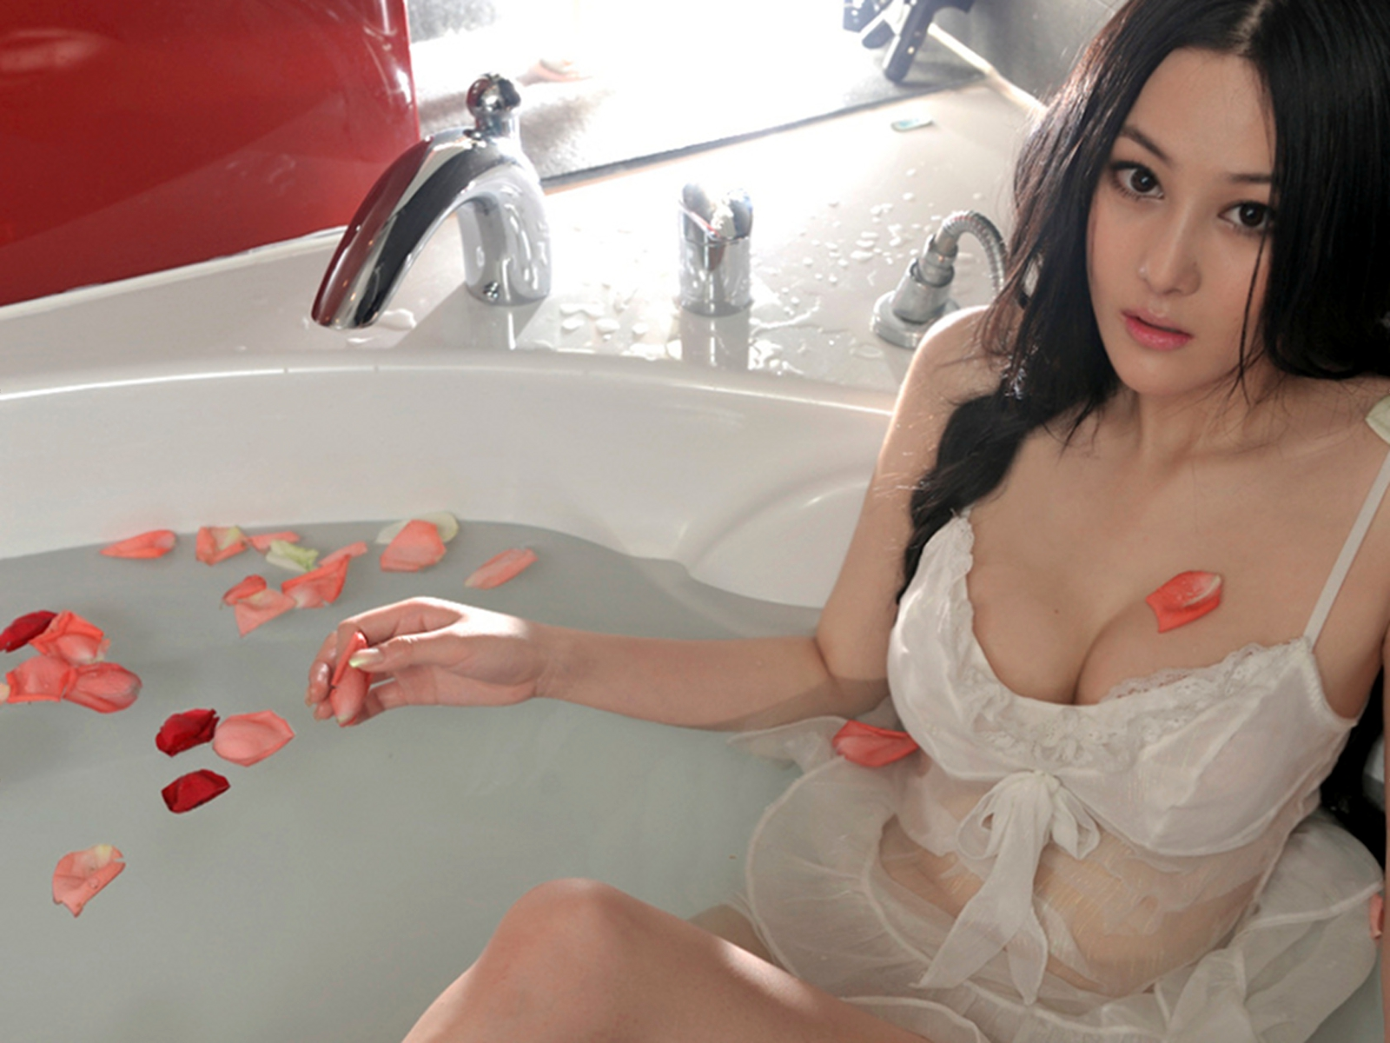
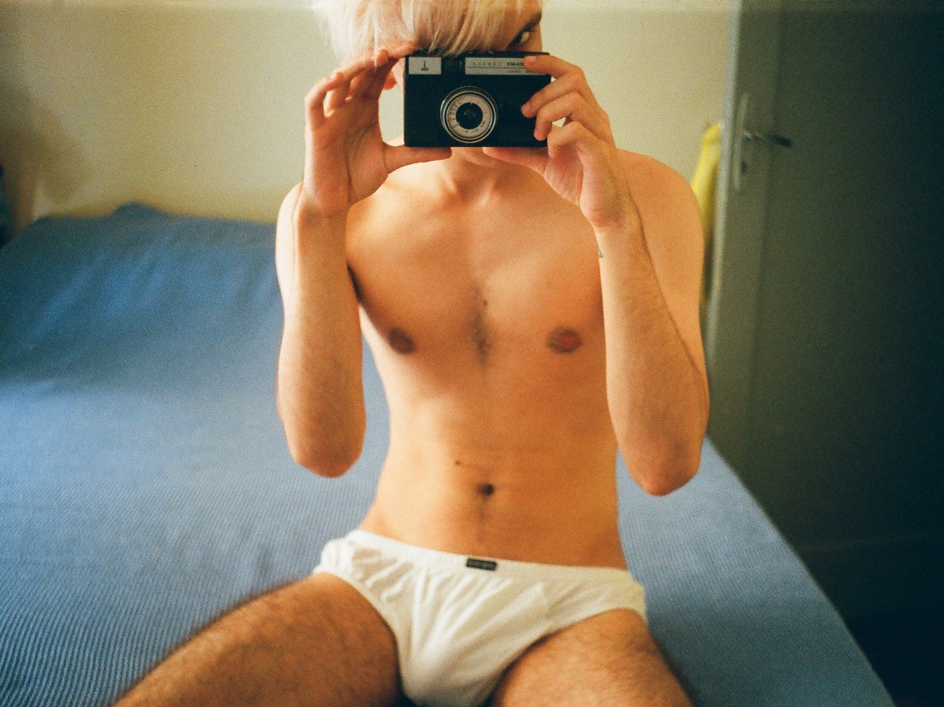
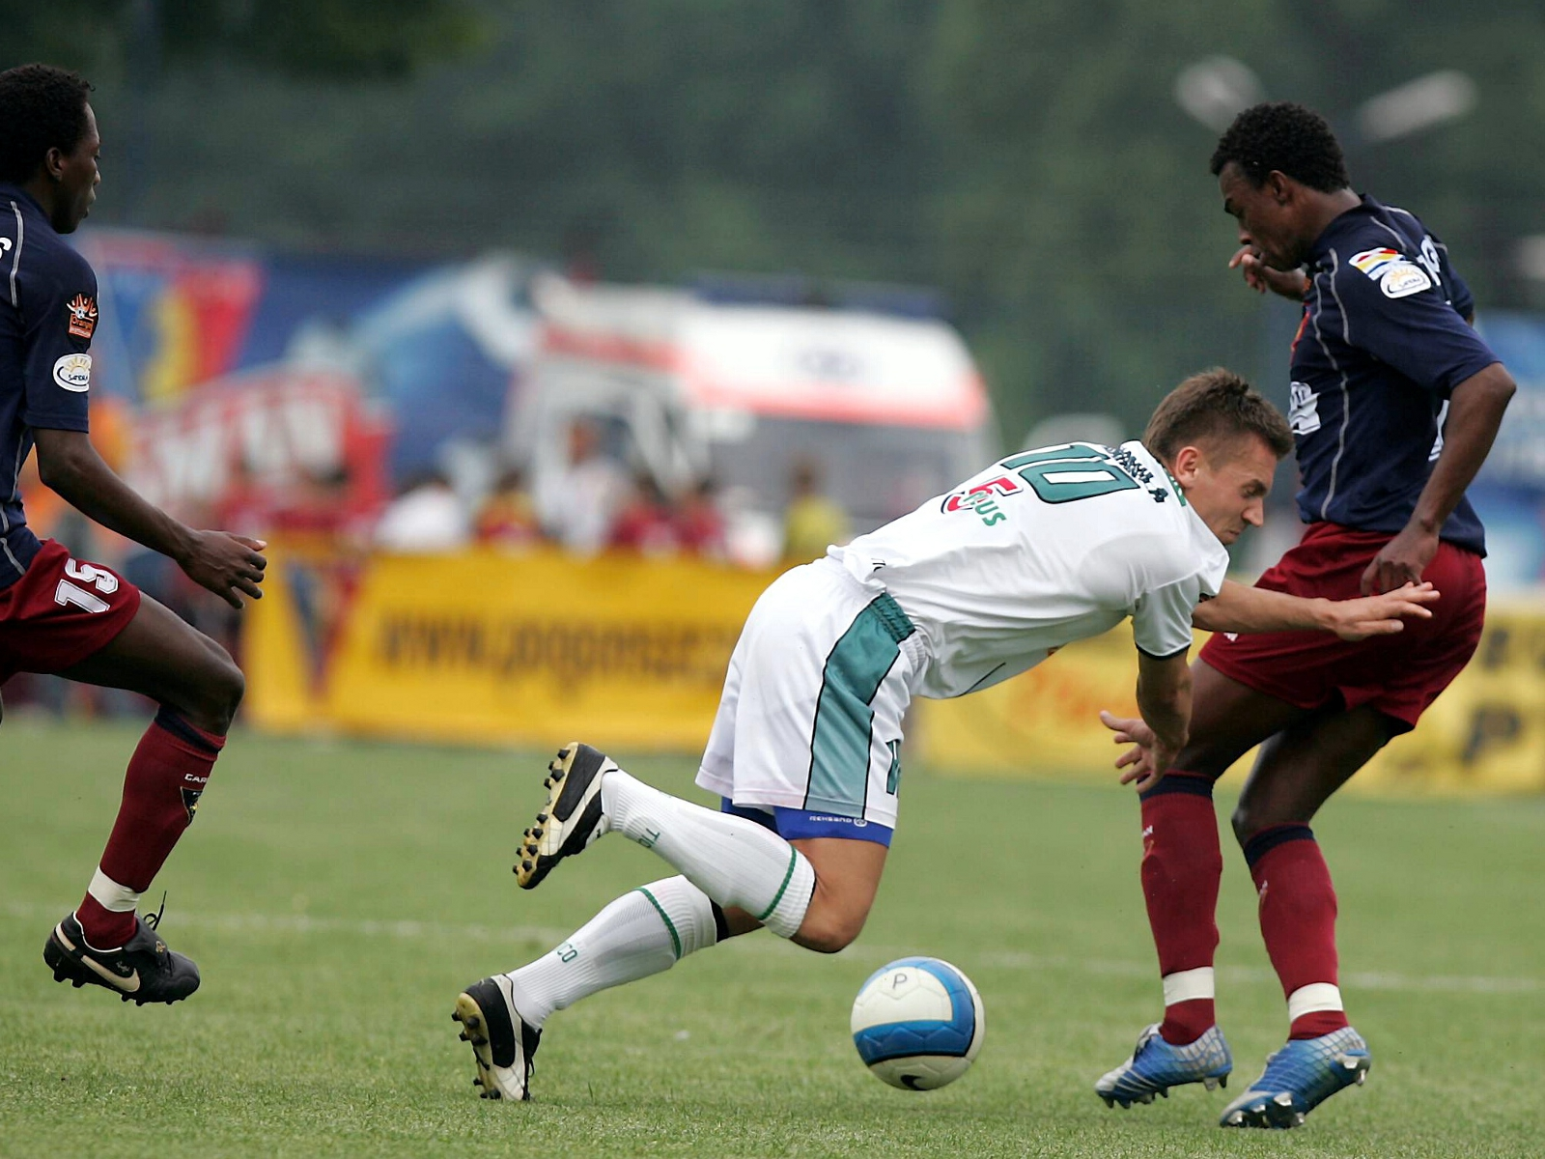
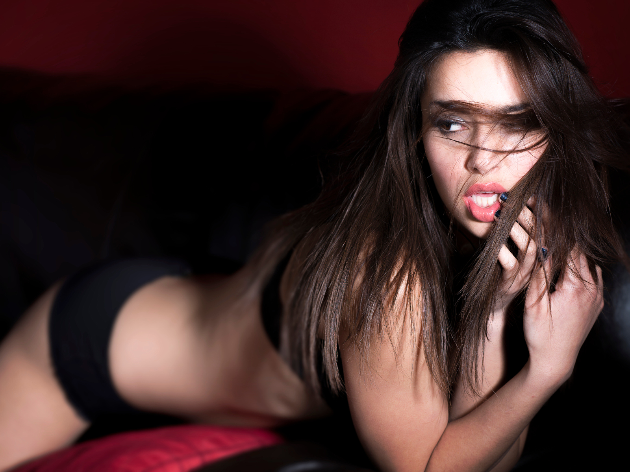
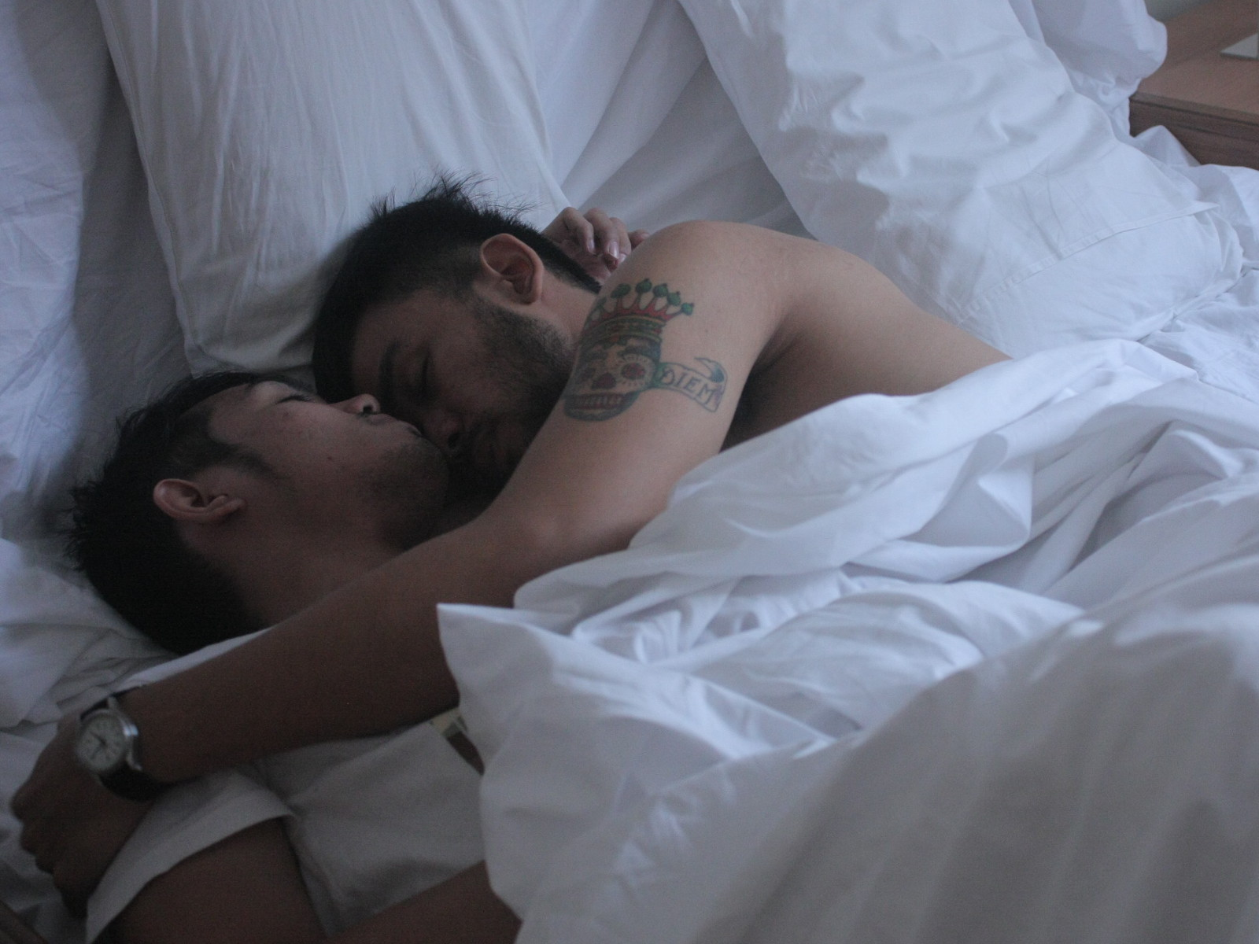
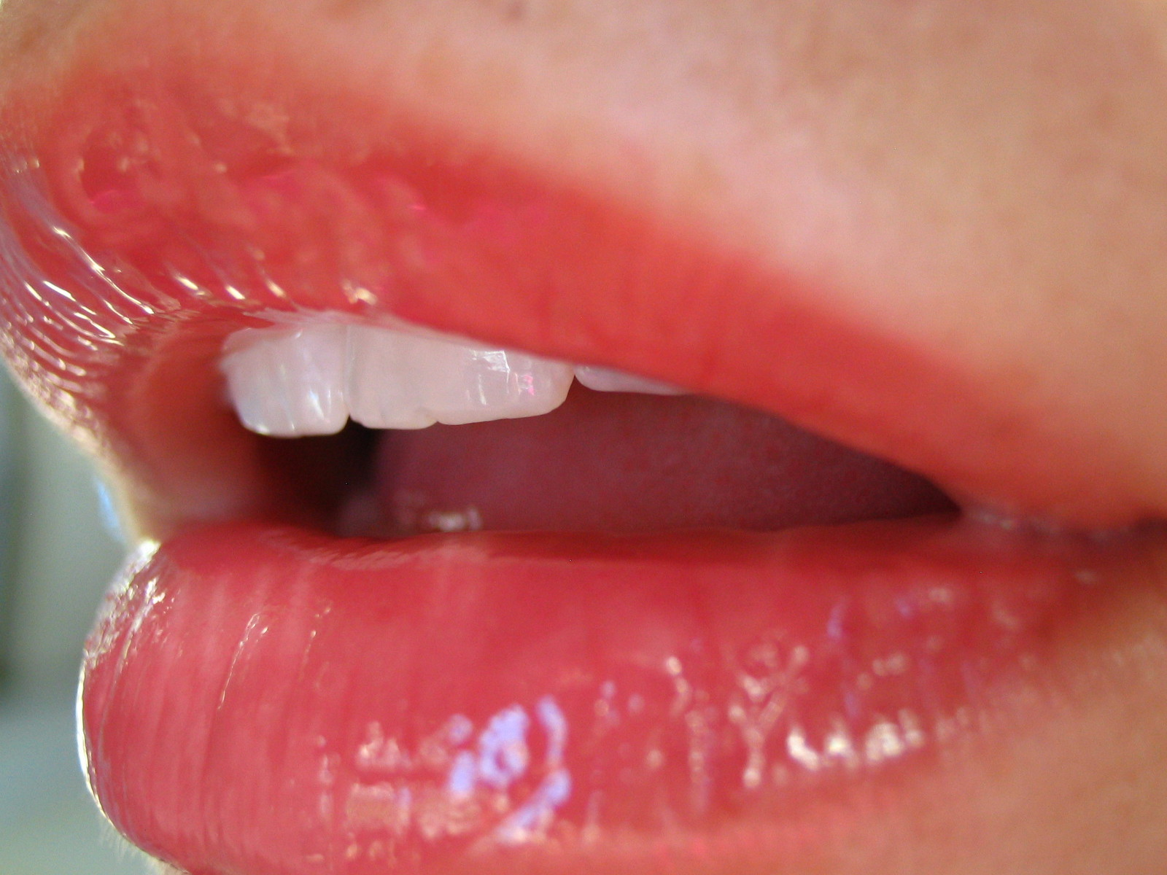
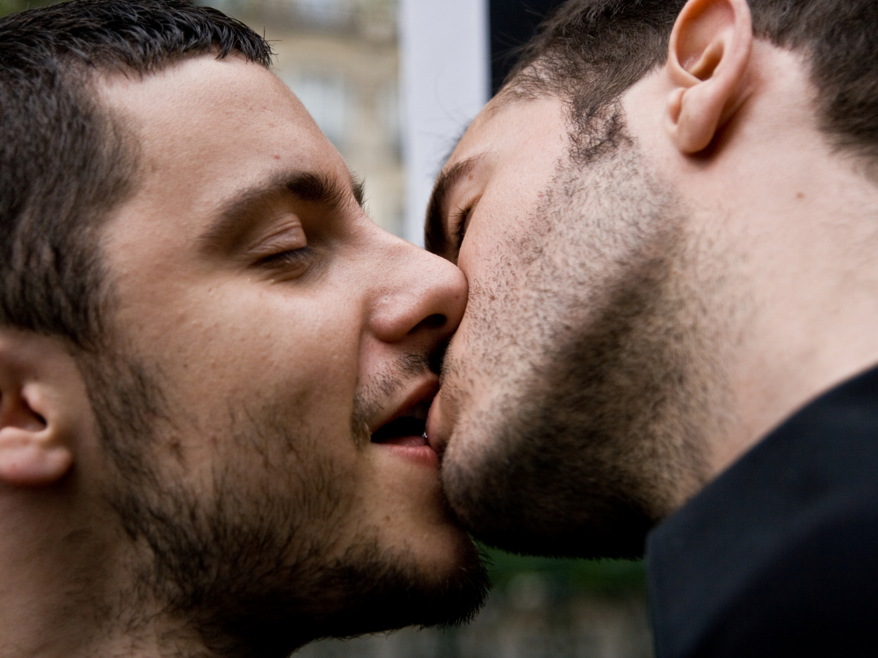
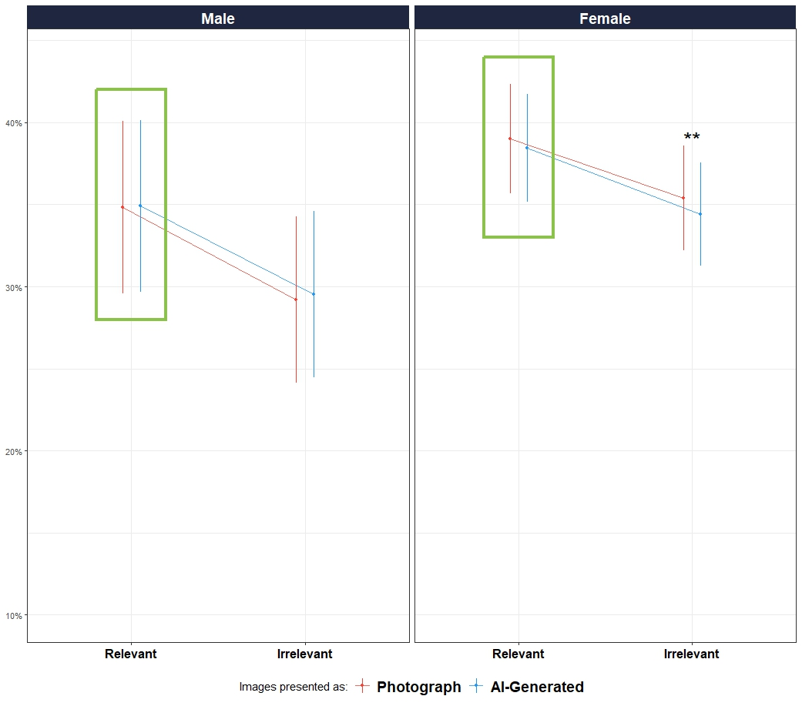
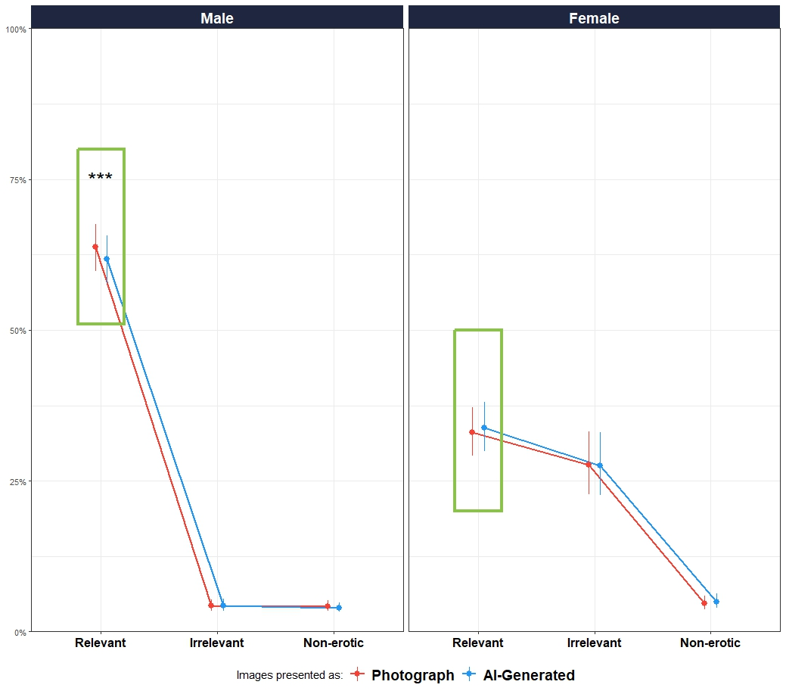
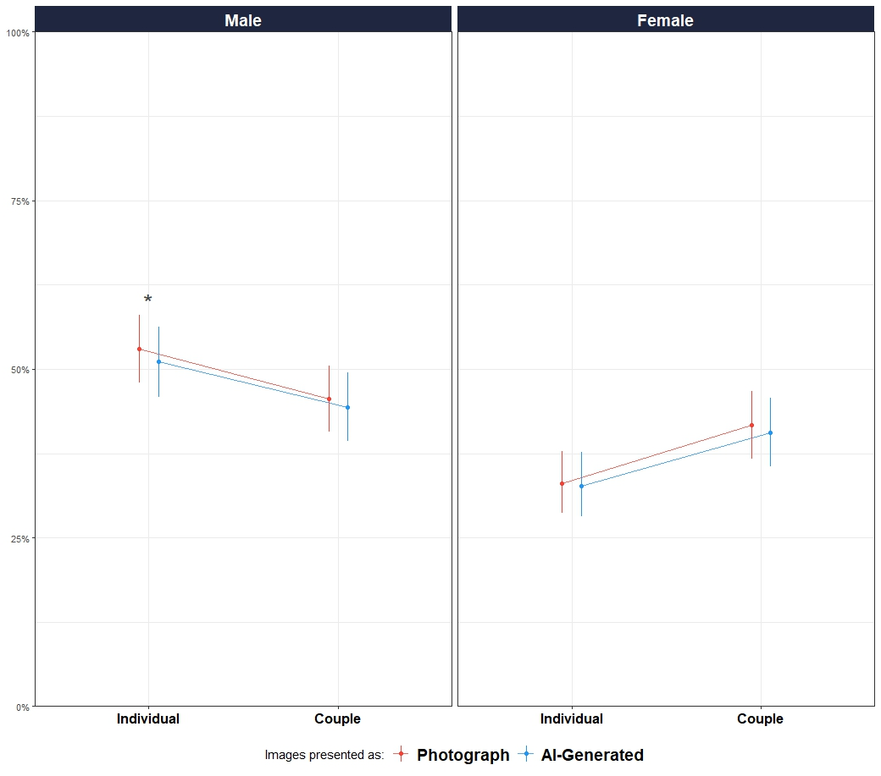


Do We Find AI-Generated Less Emotional? The Impact Of Reality Beliefs On Affective Responses
Ana Neves, ….
INTRO
Advances in AI and immersive tech (e.g., VR) are blurring the line between real and fake, making it harder for people to distinguish real from fictional - often with serious consequences, such as misinformation (Miller et al., 2023).
For instance, deepfake technologies can generate realistic fake videos of politicians, spreading false narratives (Meskys et al., 2020).
Emotions shape how we interpret and respond to our environment (Mocaiber et al., 2010) and play a key role in how we process ambiguous or fictional content. Studies show that framing stimuli as fictional reduces emotional impact:
↓ Valence & intensity for neutral/negative videos (Sperduti et al., 2016)
↓ Intensity for negative pictures (Sperduti et al., 2017) ↓ Physiological arousal, subjective arousal, intensity & valence for negative and neutral images (Makowski et al., 2019)
STUDY 1
DATABASE: American Multiracial Face Database (AMFD, J. M. Chen et al., 2021)
P H A S E 1
AI-GENERATED
STIMULI #1
SUBJECTIVE ASSESSMENT
PHOTOGRAPH
STIMULI #2
SUBJECTIVE ASSESSMENT
PHOTOGRAPH
STIMULI #3
STIMULI
VARIABLE: Attractiveness
STUDY 2
DATABASES: Nencki Affective Picture System (NAPS, Marchewka et al., 2014) AND NAPS Erotic subset (NAPS ERO, Wierzba et al., 2015)
P H A S E
2
STIMULI #3
REALNESS ASSESSMENT
STIMULI #5
REALNESS ASSESSMENT
STIMULI #1
REALNESS ASSESSMENT
STIMULI #8
REALNESS ASSESSMENT
VARIABLE: Arousal
STUDY 3
DATABASE: NAPS Erotic subset (NAPS ERO, Wierzba et al., 2015)
VARIABLE: Arousal
“AI-Generated” leads to a decrease in emotional responses”
RESULTS
STUDY 1
STUDY 2
STUDY 3
206 participants (Mean age = 27.8, SD = 13.6, range: [18, 69]; Gender: 76.7% women, 23.3% men)
705 participants (Mean age = 30.2, SD = 11.8, range: [18, 80]; Gender: 35.7% women, 64.3% men)
197 participants (Mean age = 36.5, SD = 13.1, range: [18, 80]; Gender: 48.2% women, 51.8% men)
DISCUSSION

Slide 2

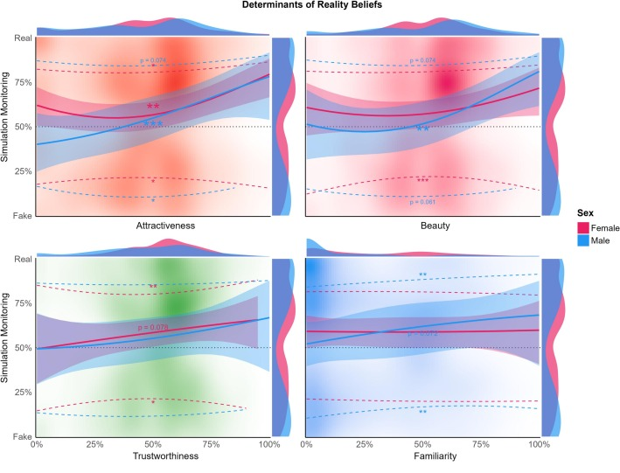
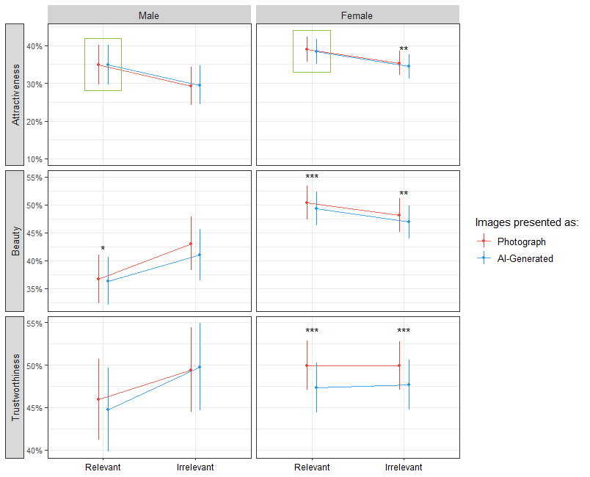
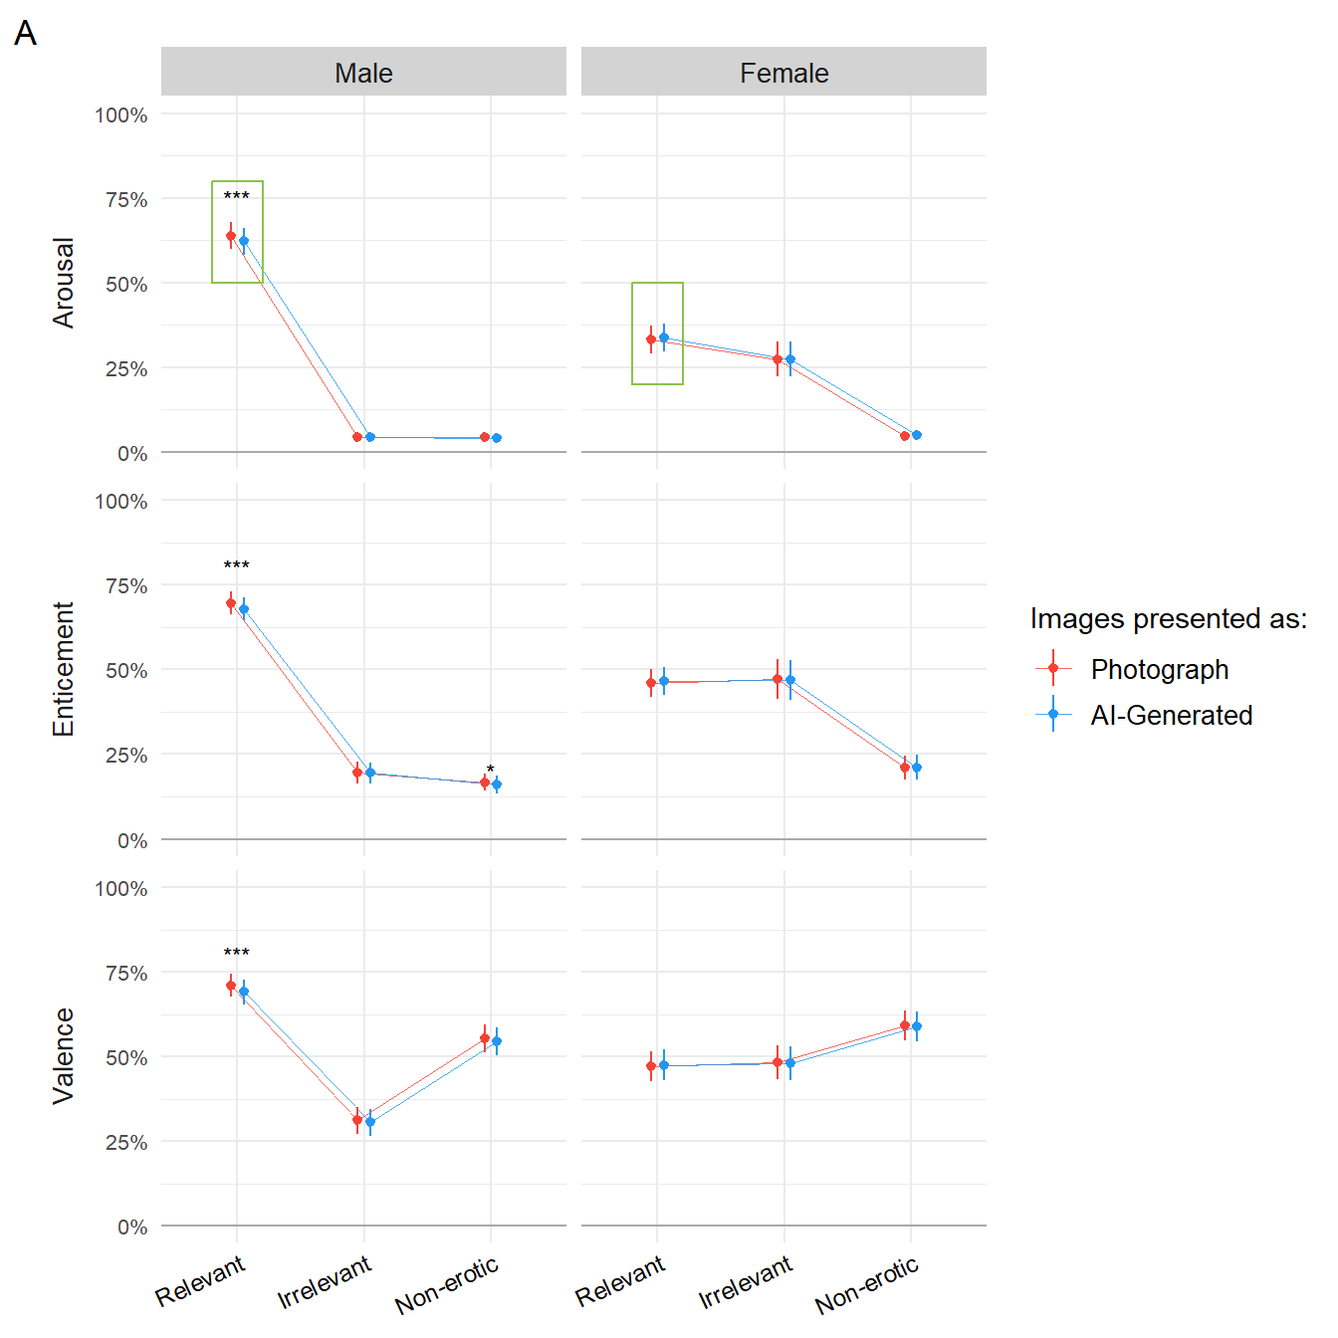
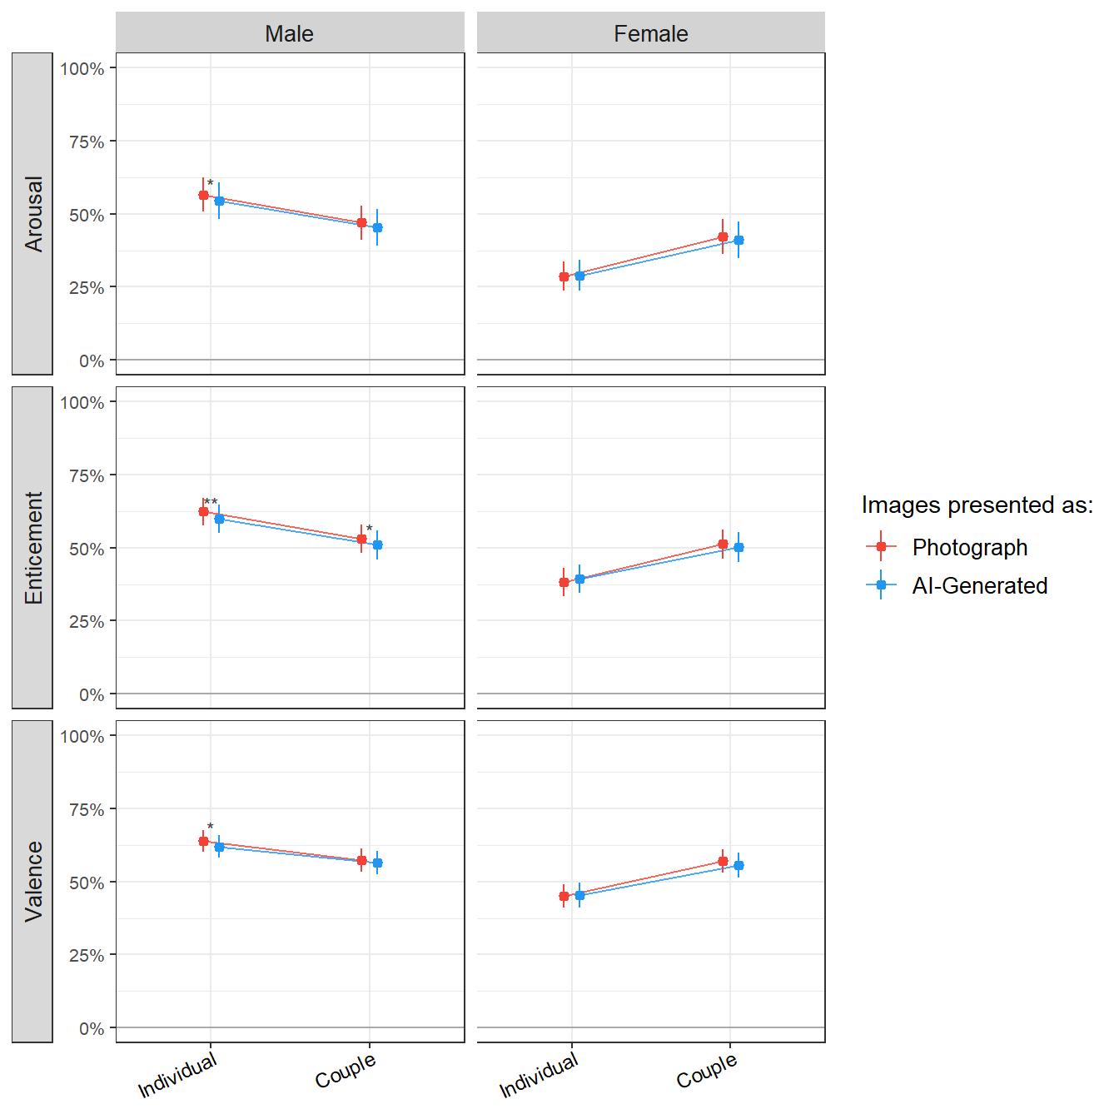


INTRO
STUDY 1*
145 participants (Mean age = 28.3, SD = 9.0, range: [19, 66]; Gender: 48.3 % females, 51.0 % males, 0.7 % others)
STUDY 2
206 participants (Mean age = 27.8, SD = 13.6, range: [18, 69]; Gender: 76.7% women, 23.3% men)
STUDY 3
705 participants (Mean age = 30.2, SD = 11.8, range: [18, 80], 0.1% missing; Gender: 35.7% females, 64.3% males)
STUDY 4
197 participants (Mean age = 36.5, SD = 13.1, range: [18, 80]; Gender: 48.2% women, 51.8% men)
Attractiveness
Trustworthiness
Beauty
Familiarity
Attractiveness
Trustworthiness
Beauty
Arousal
Enticement
Valence
Arousal
Enticement
Valence
Realness
Realness
Realness
Realness
METHODS
Stimuli: NEUTRAL FACES
Stimuli: NON-EROTIC + EROTIC IMAGES
Stimuli: NEUTRAL FACES
Stimuli: EROTIC IMAGES
NEUTRAL
FACES
American Multiracial Face Database (AMFD, J. M. Chen et al., 2021)
NON-EROTIC Nencki Affective Picture System (NAPS, Marchewka et al., 2014)
P H A S E 1
AI-GENERATED
STIMULI #1
SUBJECTIVE ASSESSMENT
PHOTOGRAPH
STIMULI #2
SUBJECTIVE ASSESSMENT
PHOTOGRAPH
STIMULI #3
EROTIC
Erotic subset for the Nencki Affective Picture System (NAPS ERO, Wierzba et al., 2015)
POSITIVE AROUSAL
STIMULI
P H A S E
2
STIMULI
STIMULI #3
REALNESS ASSESSMENT
STIMULI #5
REALNESS ASSESSMENT
STIMULI #1
REALNESS ASSESSMENT
STIMULI #8
REALNESS ASSESSMENT
“AI-Generated” leads to a decrease in emotional responses
Subjective ratings
Realness
Moderators
Subjective ratings
Realness
Moderators
Subjective ratings
Realness
Moderators
Subjective ratings
Realness
Moderators
RESULTS
Fig1. The effect of face ratings on 1) the probability of judging a face as real vs. fake (solid line) and 2) on the confidence associated with that judgement (dashed lines) depending on the sex. Stars indicate significance (p < .001***, p < .01**, p < .05*).
Realness
Realness
Realness
Realness
DISCUSSION
* Makowski, D., Te, A. S., Neves, A., Kirk, S., Liang, N. Z., Mavros, P., & Chen, S. A. (2025). Too beautiful to be fake: Attractive faces are less likely to be judged as artificially generated. Acta Psychologica, 252, 104670.
Notes:
Png transparent background for badgers#
Title , authors,

